Slide 1
SAP FTM
Month End Closing Process

Slide 2

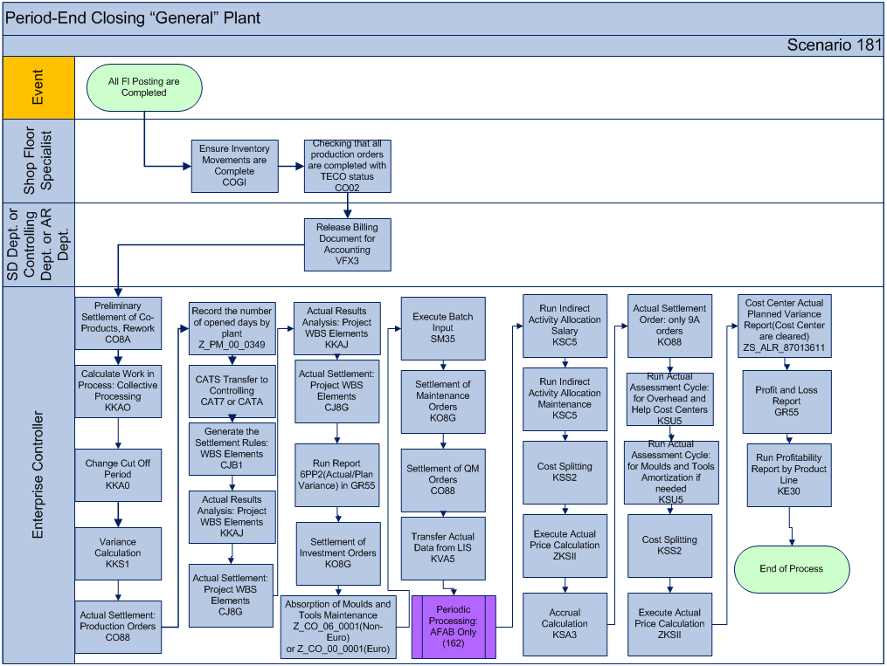
Business Process Workflow Period-end closing
PP Prod orders
PM Maint orders
M&T WBSel.
QM qual. orders
Cost centers
Internal orders
Profit center
Prof. analysis

Slide 3

Close Process Summary-Proposal by Day
Day -1
  Internal Orders Settlement (KO88)
  Depreciation Run (AFAB,ASKB)
Day 1
  Sales Orders – all invoices posted (VFX3)
  AR Closed – all payments applied
  Production Orders Settlement (CO8A,KKAO,KKA0,KKS1,CON2,CO88)
Day 2
  Payroll entries (Z_FI_00_1546)
  Recurring Journal Entries / Accruals
  AP Closed
  Inventory Depreciation (MRN2)
  VAT Posting (FB41)
  Day 3
  WBS Elements (CJB1,KKAJ,CJ8G)
  Actual/Plan Variance (GR55 6PP2)
  Internal Orders Settlement (KO8G)
  Absorption M&T Maintenance (Z_CO_06_0001)
  Maintenance Orders Settlement (KO8G)
  QM Orders Settlement (CO88)
  Currency Revaluation (F.05)
  Day 4
    Indirect Activity Allocations (KSC5)
    Actual Cost Splitting (KSS2)
    Accrual Calc for Cost Centers (KSA3)
    Actual Assessment Cycle (KSU5)
    Material Ledger (CKMLCP)
  Day 5
  Cost Center Review (ZS_ALR_87013611)
  P&L Review (GR55 Z216)
  Balance Sheet Review (S_ALR_87012284)
  Profitability by Product Line (KE30)
  P&L and Intercompany complete in BPC
  Day 6
    Balance Sheet and Sales schedules in BPC
  Day 7
    Cash Flow schedule complete in BPC (FLQREP)

